Slide 1

SQL Server Administration & Azure Data Engineering
Day 8

Slide 2

Agenda
SQL Server Performance Tuning
SQL Server Poor Performance Root Causes
SQL Server Query Optimization Techniques
SQL Server Performance Monitoring Tools
Dynamic Management Views
Azure SQL Performance Tuning
Azure SQL Query Optimization

Slide 3
SQL Server Performance Tuning
SQL Server performance tuning is a multi-layered process involving proactive monitoring, query optimization, and server configuration. The goal is to reduce response time and resource consumption (CPU, Memory, and Disk I/O)
Determine whether you can improve performance. For example, by monitoring the response times for frequently used queries, you can determine whether changes to the query or indexes on the tables are required.
Evaluate user activity. For example, by monitoring users trying to connect to an instance of SQL Server, you can determine whether security is set up adequately and test applications or development systems. For example, by monitoring SQL queries as they are executed, you can determine whether they are written correctly and producing the expected results.
Troubleshoot problems or debug application components, such as stored procedures.

Slide 4
SQL Server Performance Monitoring Tools
Microsoft SQL Server provides a comprehensive set of tools for monitoring events in SQL Server and for tuning the physical database design. The choice of tool depends on the type of monitoring or tuning to be done and the particular events to be monitored
SQL Server database functions are built-in functions display snapshot statistics about SQL Server activity since the server was started. These statistics are stored in predefined SQL server counter.
The Windows Application event log provides an overall picture of events occurring on the Windows server and Windows OS. Events in SQL Server, SQL Server Agent, Full Text Search. It contains the information about events in SQL server & error log information to troubleshoot SQL Server related problems.
Extended events is a lightweight performance monitoring system which uses very few performance resources. Extended events provides three GUI – New Session Wizard, New Session, XE profiler.

Slide 5
SQL Server Performance Tuning Tools
Live Query Statistics
Performance Monitor
Execution related DMV to check execution related information
Open Activity Monitor
Performance Dashboard
SQL Trace
Trace Flags

Slide 6
SQL Server Poor Performance Root Causes
SQL Server performance troubleshooting requires a systematic approach, often categorized into identifying whether a query is running (consuming CPU) or waiting (stalled by a bottleneck).
Waiting Queries – sys.dm_os_wait _stats to check the holding up execution
PAGEIOLATCH – slow disk reads
WRITELOG – Transaction log disk latency
LCK_m_ Sessions blocked by other queries.
Resource Semaphore – Queries waiting for memory grants.
For High CPU usage use sys.dm_exec_requests and sys.dmexec_query_statts to find queries with highest total worker time.

Slide 7
SQL Server Query Level Troubleshooting
Missing Indexes – Search for Missing index warning in the plan. Use Missing Index DMV to see global recommendations.
Outdated Statistics – if estimated vs actual row counts differ significantly run UPDATE STATISTICS on the specific tables.
SARGability – Avoid functions on indexed columns (e.g. WHERE YEAR(date_col) = 2024) as they prevent index usage.
Anti-Patterns – Replace SELECT * with specific columns and avoid N+1 Queue patterns by using JOIN.

Slide 8
SQL Server Query Optimization Techniques
Query Store – Built-in tool for tracking performance history and forcing “good” plans if a regression occurs.
Sp_WholsActive – A common standard script for seeing what’s exactly running on server now including wait types and blocking.
Database Engine Tuning Advisor – Analyses a workload and suggests indexes, partitions or indexed views.

Slide 9
SQL Server Troubleshooting
High CPU usage across all CPUs – use tools like Resource Monitor, Process Monitor , Process Explorer etc.
If a svchost process consumes high CPU usage, and the svchost process contains more than one service, you need to break each service out to run in its own svchost process to determine which service is causing the high CPU usage.
This issue may occur if the Power Options settings are set to Balanced. By default, Windows Server 2008 R2 or later sets the Balanced (recommended) power plan, which enables energy conservation by scaling the processor performance based on current CPU utilization.

Slide 10
SQL Server Slow Server Performance
ARCserve Backup Agent for Open Files or ARCserve Open File Agent from Computer Associates International, Inc. is installed on your computer, and the Ofant.sys driver for the program is outdated.
Open Transaction Manager is installed on your computer, and the Otman.sys driver for the program is outdat
A VERITAS program that uses the Otman4.sys or Otman5.sys driver (such as Open File Option) is installed on your computer, and the Otman4.sys or Otman5.sys driver for the program is outdated.
The driver for the program is incompatible with the filter driver that is installed on the computer by a non-Microsoft antivirus program. As a result, the filter driver on the server may return an incorrect status code to the Server service. For example, the filter driver may return a STATUS_SUCCESS code instead of a STATUS_OPLOCK_BREAK_IN_PROGRESS code.
To resolve this issue, contact the manufacturer of the program to inquire about the availability of a filter driver update. For more information about how to contact Computer Associates to obtain the latest update for the Ofant.sys driver

Slide 11
SQL Server Performance Monitoring Tools
Activity Monitor – Provides a real-time “snapshot” of server health, displaying graphs for CPU utilization, waiting requests and expensive queries.
Extended Events: Performance Monitoring system replaced the deprecated SQL Server Profiler for capturing detailed event data with minimal overhead.
Query Store – Automatically captures a history of queries, execution plans and runtime statistics to identify performance regressions.
Windows Performance Monitor (PerfMon) A Windows OS tool used to track system resources (CPU, memory, Disk I/O) and correlate them with SQL server specific counters.

Slide 12
SQL Server Database Tuning Advisor
The SQL Server Database Engine Tuning Advisor (DTA) is a built-in tool that analyzes query workloads and recommends physical design changes—such as indexes, indexed views, and partitioning—to improve performance.
Workload Analysis: Evaluates a set of Transact-SQL statements (workload) from sources like the Query Store (SQL 2016+), plan cache, or SQL Server Profiler trace files.
Recommendations: Suggests adding, dropping, or modifying indexes (clustered and non-clustered) and partitioning strategies.
What-If Analysis: Allows users to perform exploratory analysis by simulating physical design changes without actually implementing them.
Actionable Scripts: Generates Transact-SQL scripts to implement the recommended changes immediately or at a scheduled time

Slide 13
SQL Server Dynamic Management View
Dynamic Management Views (DMVs) and Functions (DMFs) are built-in system objects in SQL Server that provide real-time insights into server state, health, and performance.
Real-Time Data: Most DMVs reflect the current state or cached data since the last SQL Server restart.
Virtual Nature: They behave like standard views and can be queried using SELECT statements.
Naming Convention: All DMVs and DMFs exist in the sys.schema and their names start with dm_ (e.g., sys.dm_exec_requests).
Compatibility Warning: Microsoft may change DMV schemas between versions; it is recommended to avoid SELECT * in production code to prevent breaking applications.

Slide 14
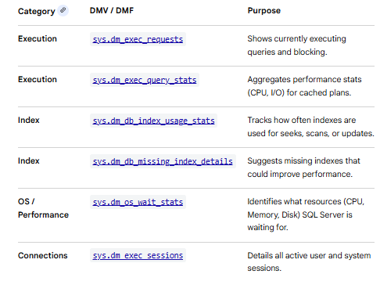
SQL Server DMVs for Performance Tuning

Slide 15
Azure SQL Server Performance Tuning
Performance tuning for Azure SQL involves a combination of leveraging built-in automated tools, optimizing application design, and manual database adjustments.
Automatic Tuning: Continuously monitors query performance and can automatically implement recommendations.
FORCE_LAST_GOOD_PLAN: Detects plan regressions and forces the last known good execution plan.
CREATE_INDEX / DROP_INDEX: Identifies and automatically creates missing indexes or removes unused ones to improve speed and reduce overhead.
Query Performance Insight: A visual tool in the Azure portal to identify top resource-consuming (CPU, Data IO, Log IO) and long-running queries.
Database Advisors: Provides specific recommendations for indexing, parameterization, and schema changes based on actual workload patterns

Slide 16
Azure Application & Infra Best Practices
Reduce "Chatty" Behavior: Minimize round trips by using batch queries or moving logic into stored procedures.
Implement Caching: Use Azure Cache for Redis or client-side caching to store frequently accessed data and reduce read pressure on the database.
Connection Pooling: Properly configure connection pool settings (e.g., maximum connections and timeouts) to manage concurrency effectively.
Retry Logic: Implement transient error handling to gracefully manage brief connectivity or resource-related failure.
Service Tiers: Switch between DTU and vCore models or upgrade to a higher performance level if CPU or IO consistently hits limits (e.g., above 80%).
Storage Best Practices (for SQL VMs): For SQL Server on VMs, ensure data and log files are on separate premium SSDs and use a 64-KB allocation unit size.
Memory Management: For Managed Instances, use flexible memory allocation to match memory-intensive workloads

Slide 17
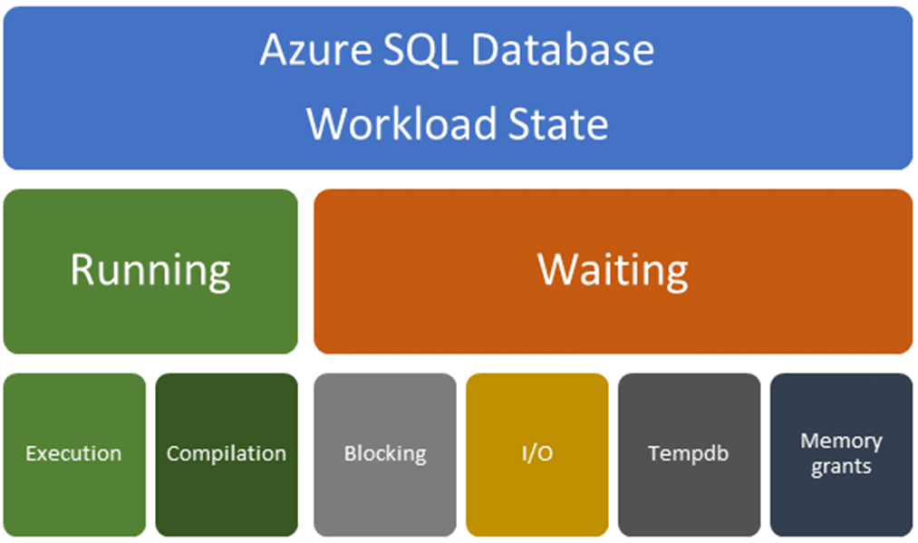
Azure SQL database Detect Performance Bottlenecks

Slide 18
Azure SQL DB Wait related Issues
Blocking:
One query might hold the lock on objects in the database while others try to access the same objects. You can identify blocking queries by using DMVs or database watcher. For more information, see Understand and resolve Azure SQL Database blocking problems.
IO problems
Queries might be waiting for the pages to be written to the data or log files. In this case, check the INSTANCE_LOG_RATE_GOVERNOR, WRITE_LOG, or PAGEIOLATCH_* wait statistics in the DMV. See using DMVs to identify IO performance issues.
Tempdb problems
If the workload uses temporary tables or there are tempdb spills in the plans, the queries might have a problem with tempdb throughput. To investigate further, review identify tempdb issues.
Memory-related problems
If the workload doesn't have enough memory, the page life expectancy might drop, or the queries might get less memory than they need. In some cases, built-in intelligence in Query Optimizer will fix memory-related problems. See using DMVs to identify memory grant issues

Slide 19
Wrap Up
SQL Server Performance Tuning
SQL Server Slow Performance Reasons
SQL Server Monitoring Tools
Azure SQL Server Performance Tuning

